Slide 1

Tomosynthesis Machine Learning

Slide 2
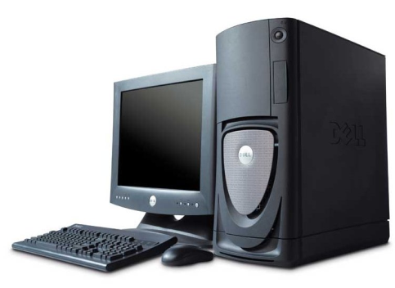
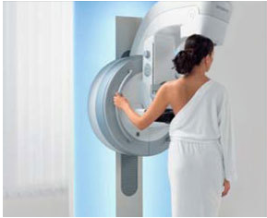
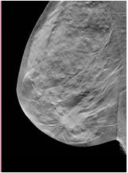
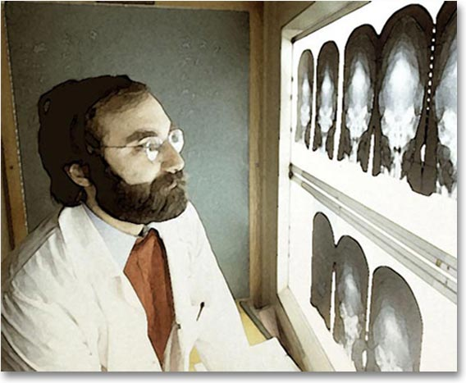
Overview
Computer aided diagnosis of breast cancer
Cancer
OR
no Cancer

Slide 3
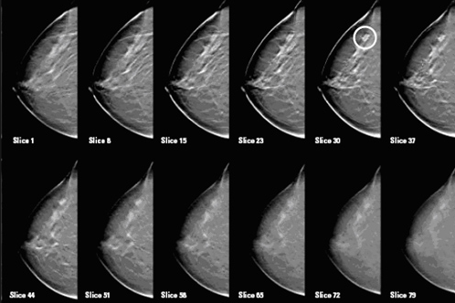
Overview
Data/Images
Large Volume (300 ~ 500 MB): 16 bits compressed video
3D Reconstruction: including 50~70 slices typically
High Resolution: (1000~1500)* (2000~2500) pixels

Slide 4
Platform/Tools
Operating Systems
Computer Languages
Windows
Linux
…
Python (PIL, scipy, scikit)
C++ (VTK, ITK, VXL, opencv)
…

Slide 5
Techniques
Image Processing
Machine Learning
Denoising/Smoothing/Enhancement
Transformation (cosine transform, wavelet transform)
Segmentation (graph-cut, region growing)
…
Convolution/ FFT
Feature Extraction
Dimensionality Reduction
Classification
…
Matrix Computation

Slide 6
Techniques
Parallel/Shared Memory Computing
Optimizing
Parallel among different slices
Parallel among different ROI
Parallel among boosting schemas
…
Optimization of algorithms
Optimization of implementation
…

Slide 7
Current Progress
Images
Preprocessing
Mass Extraction
Calcification
Segmentation
Graph cut
Mass detection
Wavelet/gabor
Calcification Detection
LOG
Feature Extraction
Reducing False positive by classification
Feature Extraction
Refine among neighboring slices
Classification

Slide 8
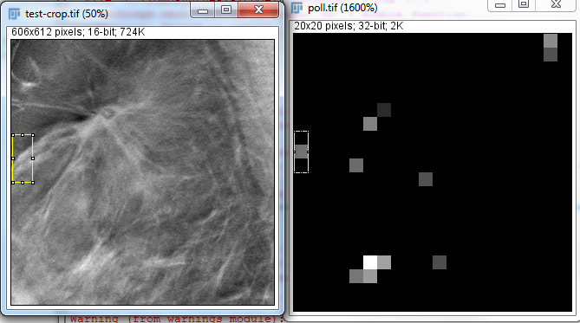
Current Progress
Mass Detection

Slide 9
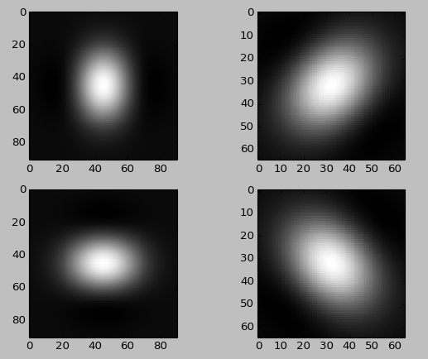
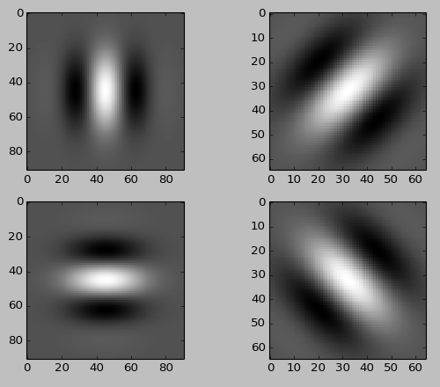
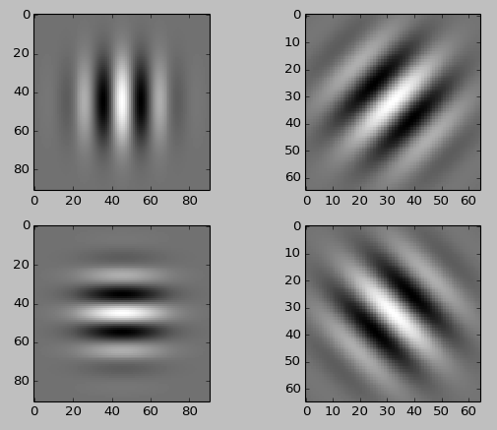
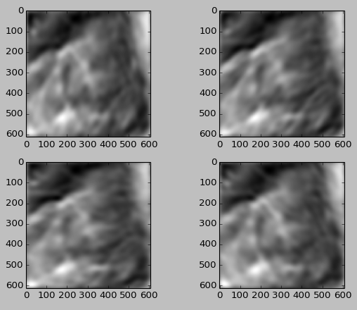
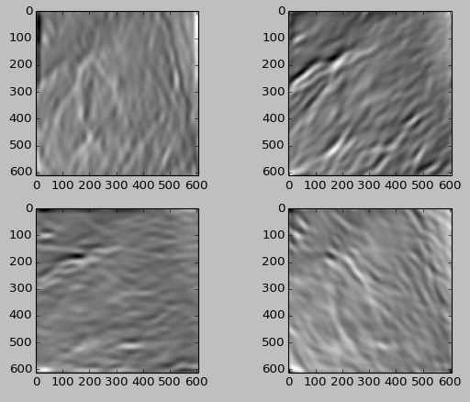
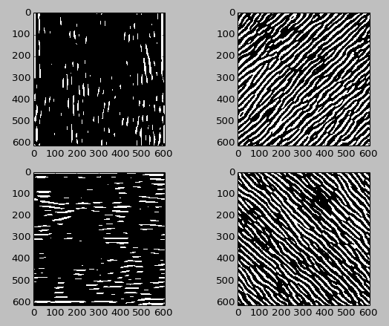
Mass Detection
Gabor kernel

Slide 10
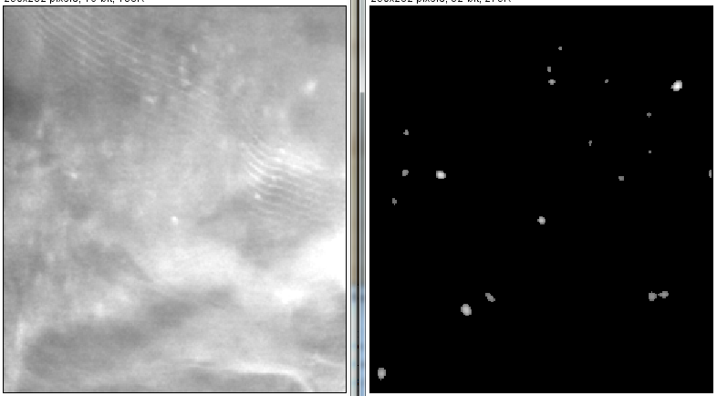
Current Progress
Calcification Detection

Slide 11
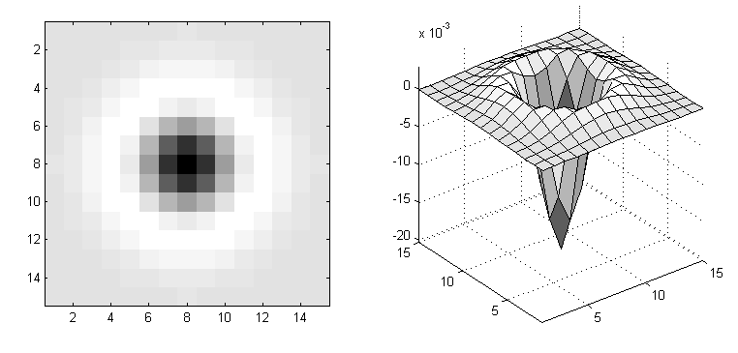
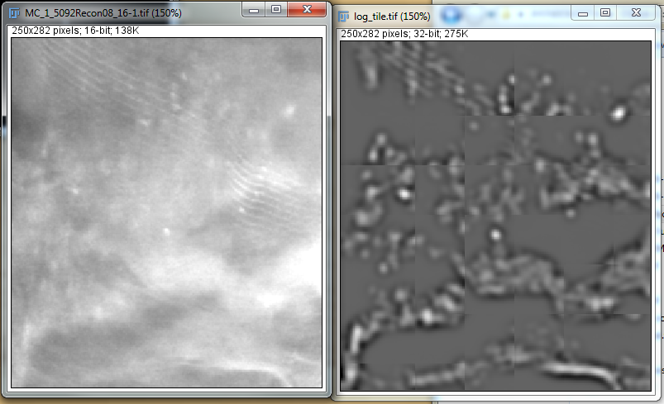
Current Progress
Calcification Detection
LOG filter

Slide 12
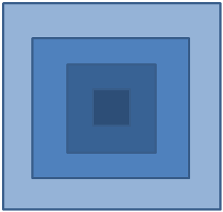
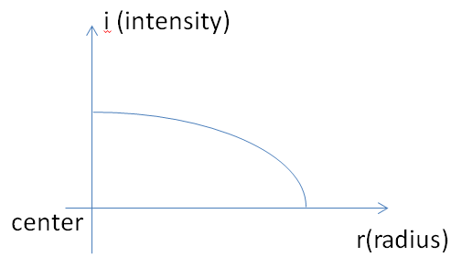
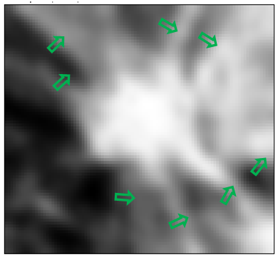
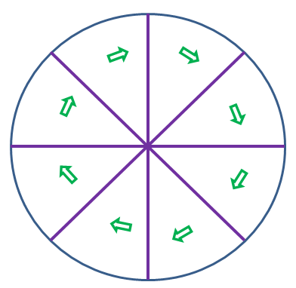
Current Progress
Classification
Statistic intensity feature
Statistic texture feature

